Slide 1
Distracted Driver Image Classification with Amazon SageMaker
DSBA 6190 Final Project
May 2020
Evan Canfield ● Roma Dutta ● Shilpa Patil ● Ibrokhim Sadikov

Slide 2
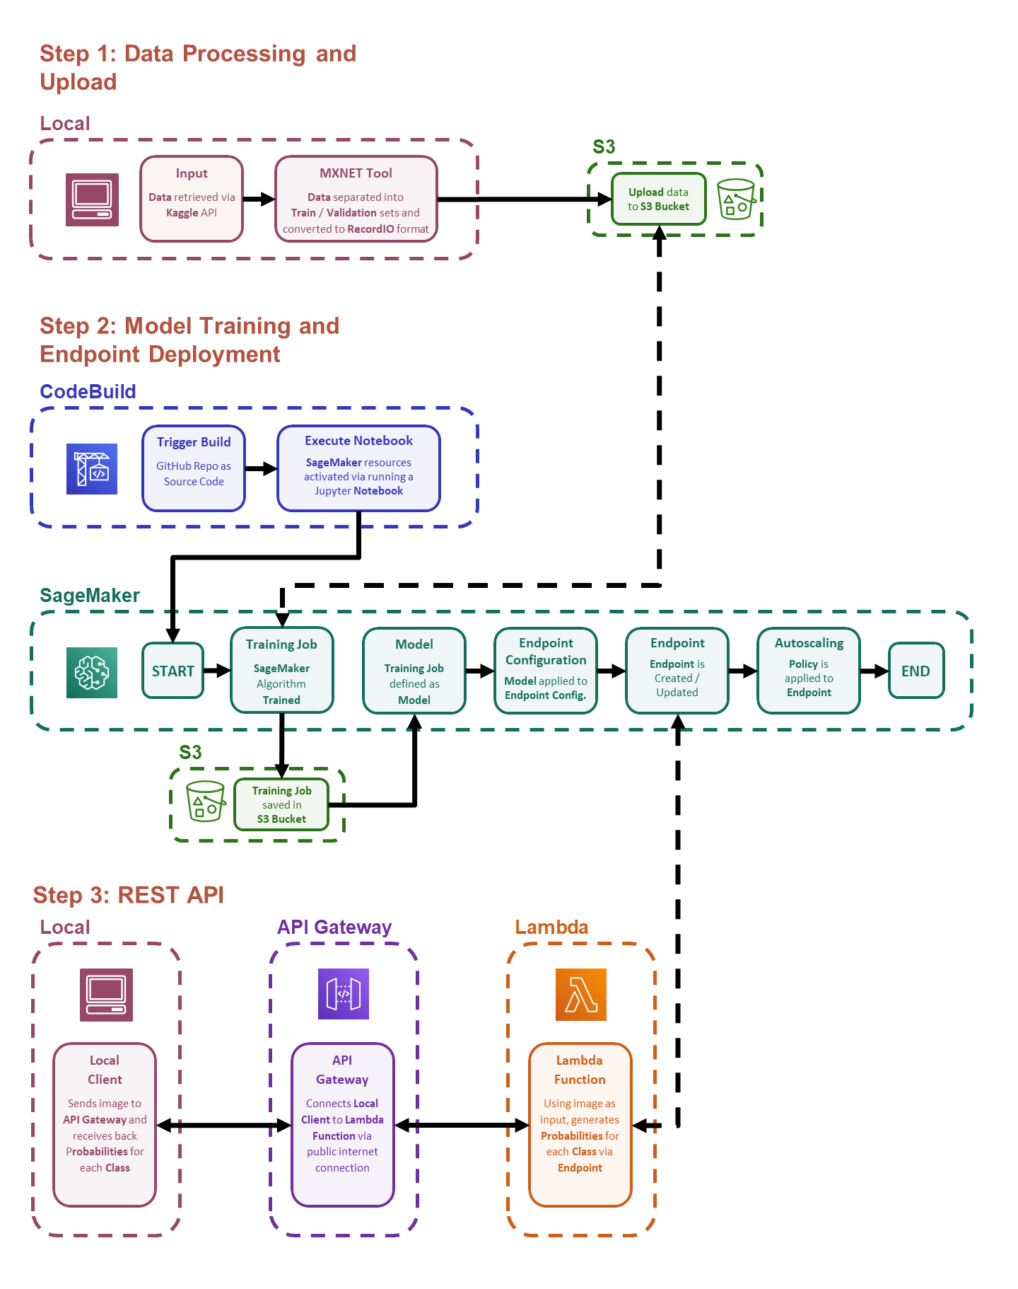

Slide 3
Steps
Data Processing and Upload
Model Training and Endpoint Deployment
REST API

Slide 4
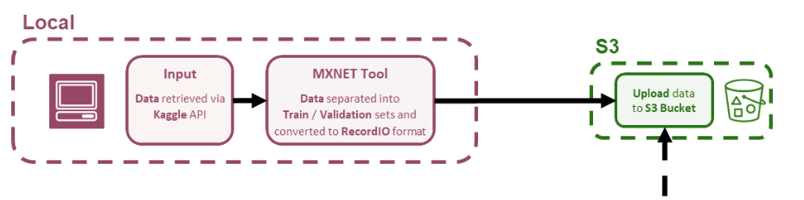
Step 1: Data Processing and Upload

Slide 5
Step 1: Data Processing and Upload

Slide 6
Step 1: Data Processing and Upload

Slide 7
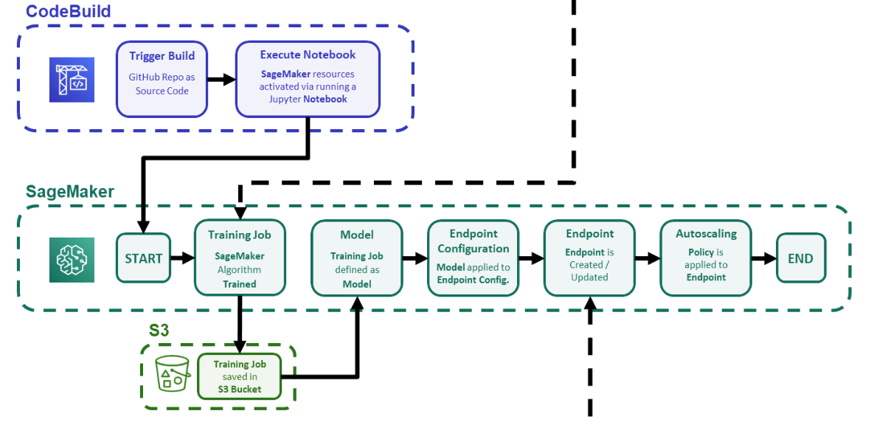

Step 2: Model Training and Endpoint Deployment
S3
Upload data
to S3 Bucket

Slide 8
Step 2: Model Training and Endpoint Deployment
S3
Upload data
to S3 Bucket

Slide 9
Step 2: Model Training and Endpoint Deployment
S3
Upload data
to S3 Bucket

Slide 10

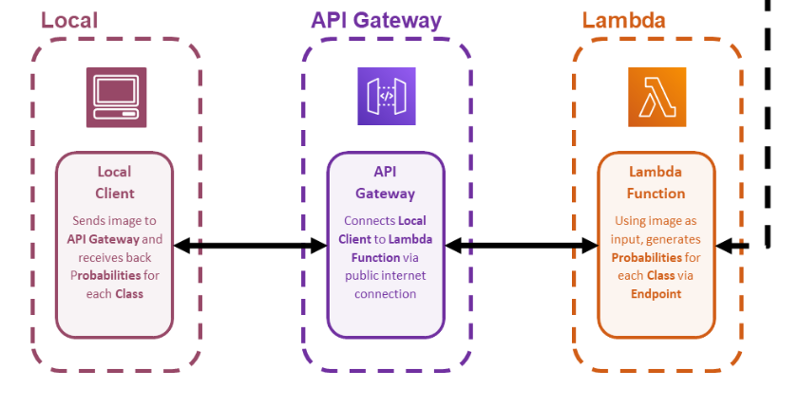
Step 3: REST API
SageMaker
Endpoint
Endpoint is Created / Updated

Slide 11
Step 3: REST API
SageMaker
Endpoint
Endpoint is Created / Updated

Slide 12
Step 3: REST API
SageMaker
Endpoint
Endpoint is Created / Updated

Slide 13
Step 3: REST API
SageMaker
Endpoint
Endpoint is Created / Updated

Slide 14
Step 3: REST API
SageMaker
Endpoint
Endpoint is Created / Updated

Slide 15
Step 3: REST API
SageMaker
Endpoint
Endpoint is Created / Updated

Slide 16
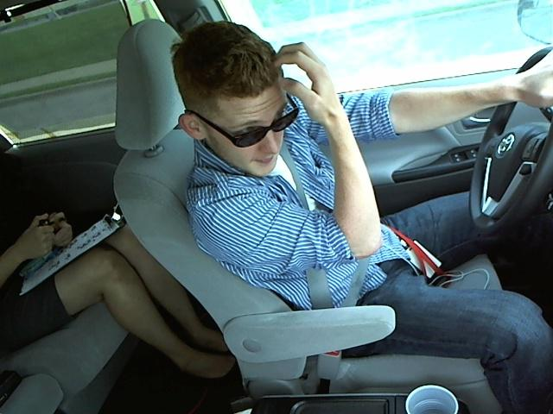
REST API Evaluation
Input:
Output:
Class C8 (Hair and Makeup)

Slide 17
REST API Evaluation
Input:
Output:
{
"payload": [
0.0004917857004329562,
0.0009714150219224393,
0.00037492465344257653,
0.0005540588754229248,
0.000527076655998826,
4.445736340130679e-05,
0.03505537286400795,
0.0012092252727597952,
0.960708737373352,
6.294571358012035e-05
]
}
Class C8 (Hair and Makeup)

Slide 18
Load Test
Insert Locust Ramp Up Image

Slide 19
Load Test
AWS Invocation per Instance Image

